Slide 1
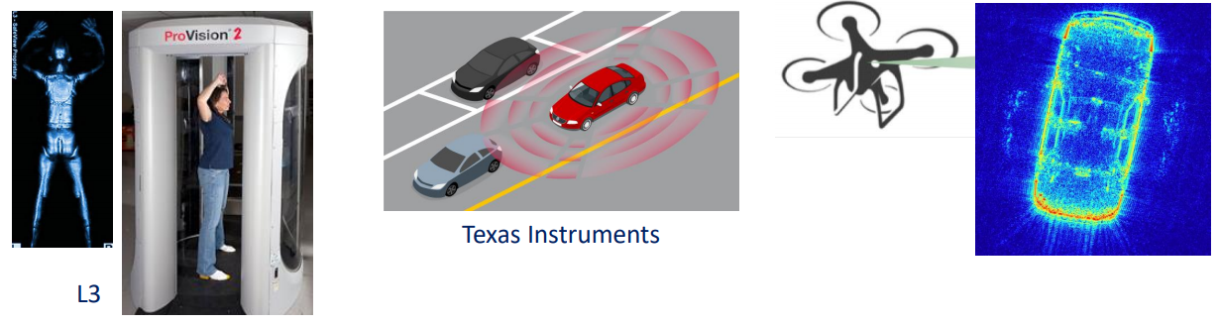

Motivation
Millimeter-wave imaging sensors have a large application space including security sensing, automotive radar, high-resolution imaging, and many more!
Goal: Construct a high resolution mmWave imaging system for holographic 3-D image reconstruction using ISAR techniques and commercially available mmWave radar sensors
Approach: Develop an efficient Fourier-based algorithm for MIMO-ISAR image reconstruction and build an x-y-$θ$ mechanical scanner to synthesize both rectangular and cylindrical apertures.
Notes:
Millimeter-wave sensors have recently emerged as a promising solution to a variety of sensing problems in the arenas of security sensing, automotive radar, high-resolution imaging, and more. Additionally, millimeter-wave radar devices are becoming increasingly affordable due to advancements in system-on-chip RF integrated circuit technology.
The goal of this work is to construct a high resolution mmWave imaging system for holographic 3-D image reconstruction using ISAR techniques and commercially available mmWave radar sensors.
To accomplish this goal, we develop an efficient Fourier-based algorithm for MIMO-ISAR image reconstruction and build a three-dimensional mechanical scanner to synthesize both rectangular and cylindrical apertures.

Slide 2
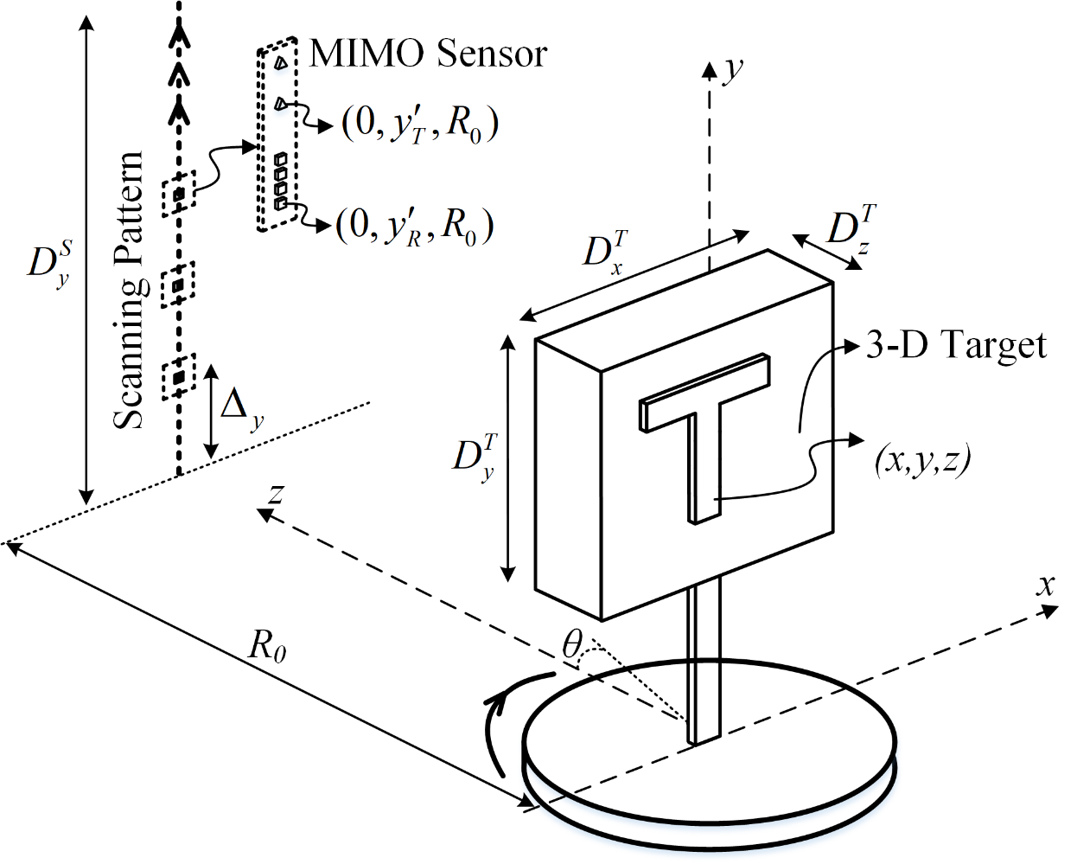
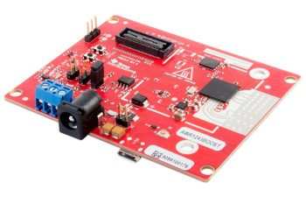

MIMO-R-ISAR System Configuration
Move the radar along the y-axis
Rotate the target at constant radial distance $R_{0}$ from radar
TI mmWave radar (IWR1443Boost)
2 Tx, 4 Rx channels
8 channel colinear multistatic-MIMO virtual array
Notes:
Our system consists of three main components: a linear vertical scanner, rotator, and FMCW radar. The linear mechanical scanner moves the radar along the y-axis up and down. The target is mounted to the rotator, which rotates the target at a constant radial distance (R naught) from the radar scanning plane. The target coordinates are in (x, y, z) and the position of each element in the synthetic aperture are at the points (R naught cosine theta, y’, R naught sine theta) in (x, y, z) space. Lastly, we will use a TI mmWave radar with 2 Tx and 4 Rx channels resulting in an 8-channel colinear multistatic-MIMO virtual array.

Slide 3
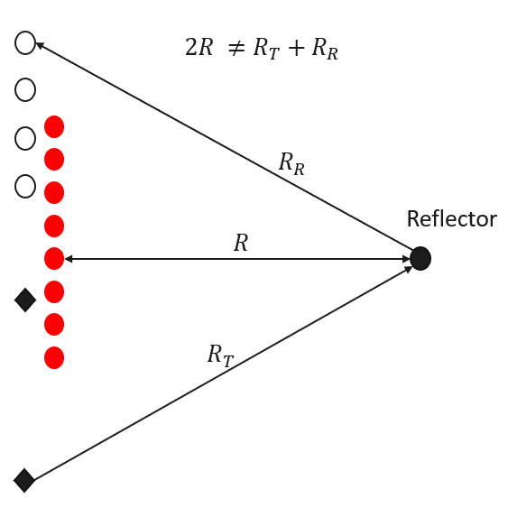
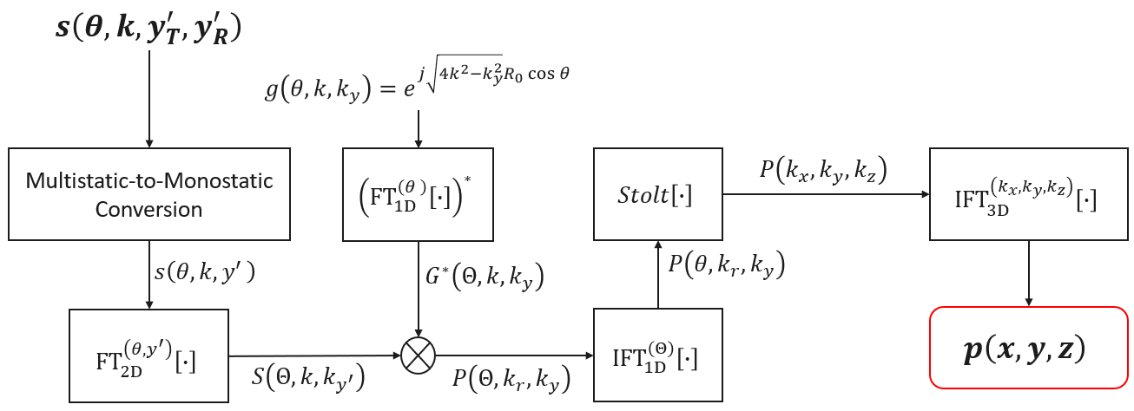
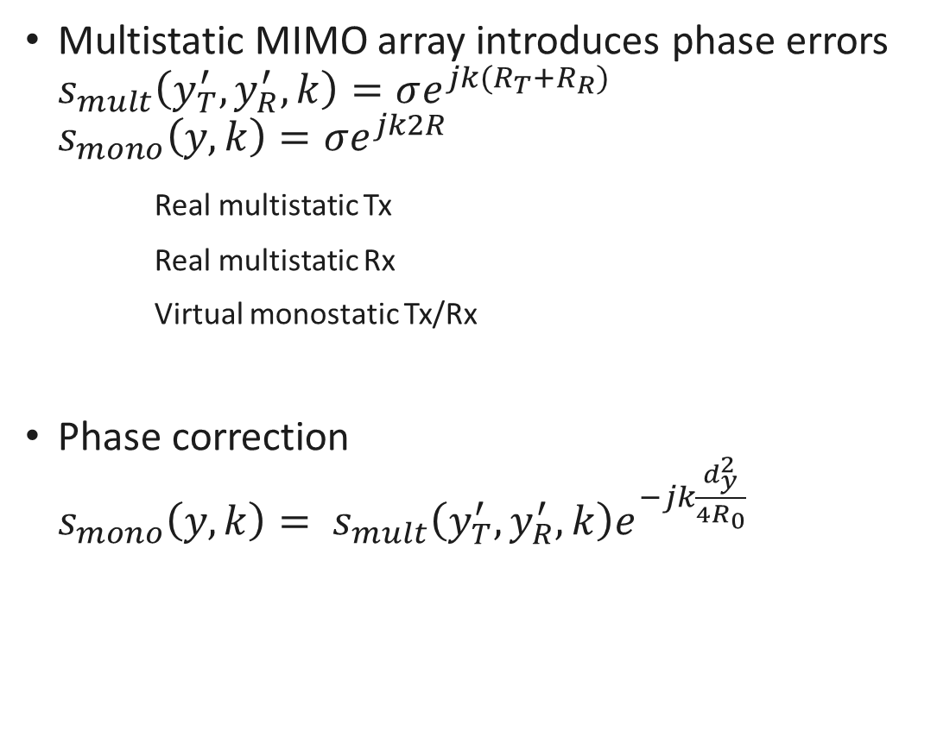
Multistatic-to-Monostatic Conversion
Multistatic MIMO array introduces phase errors
$$s_{mult}\left(y_{T}^{′},y_{R}^{′},k\right)=σe^{jk(R_{T}+R_{R})}$$
$$s_{mono}\left(y,k\right)=σe^{jk2R}$$
Real multistatic Tx
Real multistatic Rx
Virtual monostatic Tx/Rx
Phase correction ${s_{mono}\left(y,k\right)= s}_{mult}\left(y_{T}^{′},y_{R}^{′},k\right)e^{−jk\frac{d_{y}^{2}}{4R_{0}}}$
Notes:
Even though the multistatic MIMO array can be approximated by a virtual array of elements at the midpoint of each Tx/Rx pair, the multistatic nature of the MIMO radar introduces phase errors compared to the virtual monostatic array.
However, for small distances between Tx and Rx elements, these errors can be somewhat compensated for using a phase correction known in the literature and expressed below. This multistatic-to-monostatic conversion enables the use of spatially efficient MIMO arrays and computationally efficient monostatic image reconstruction algorithms.

Slide 4
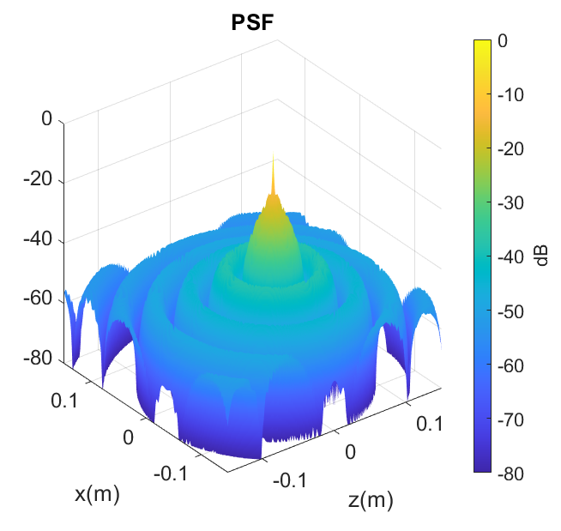
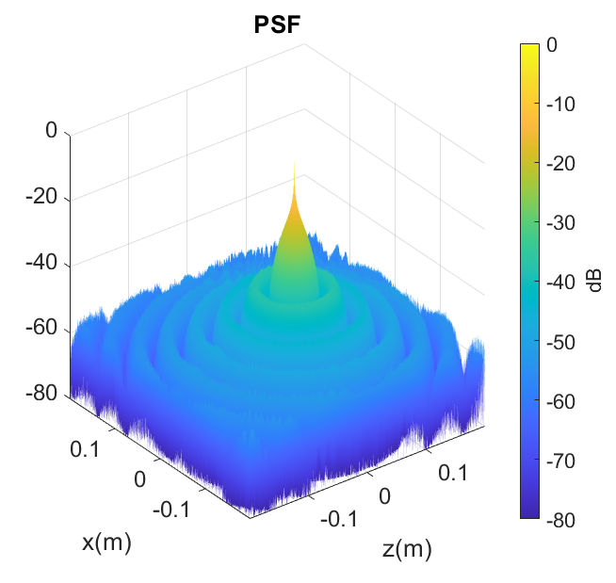
Simulations – 2-D PSF vs. Back Projection
BPA (114s)
PFA (500ms)

Slide 5
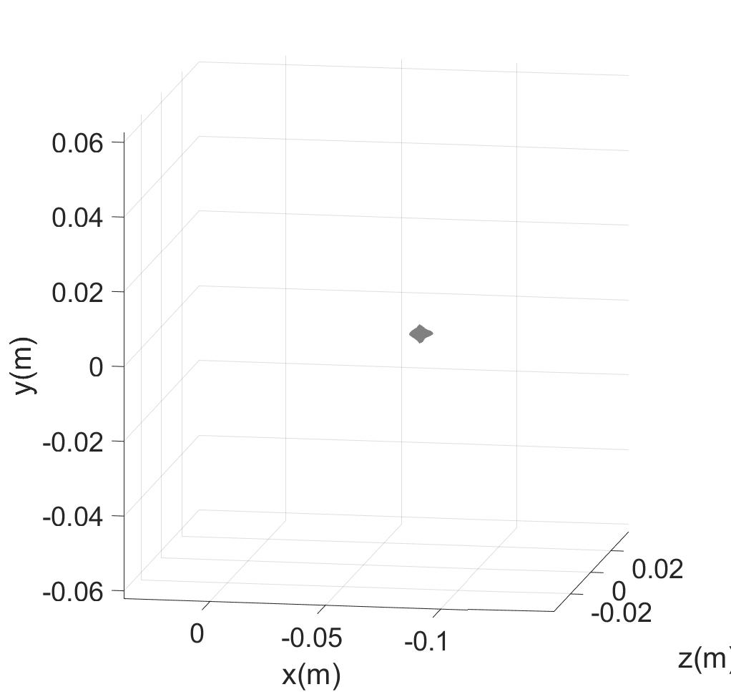
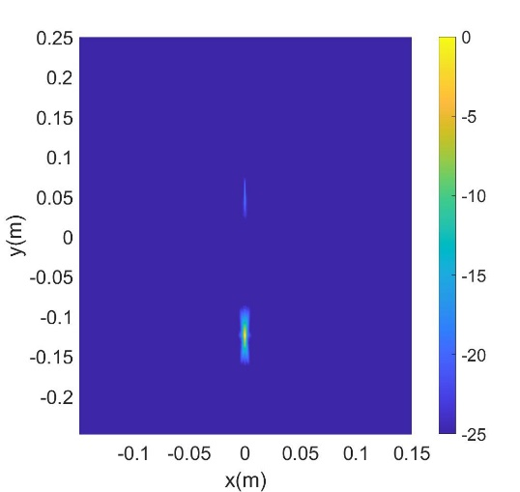
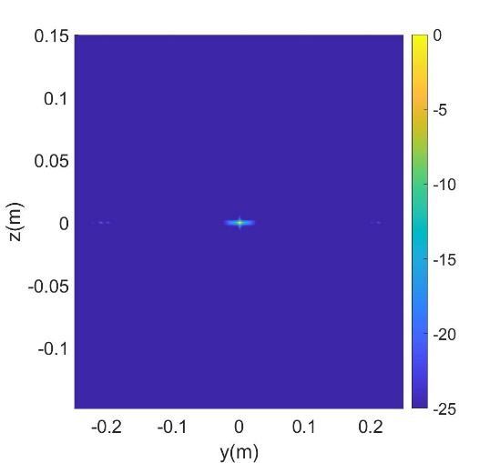
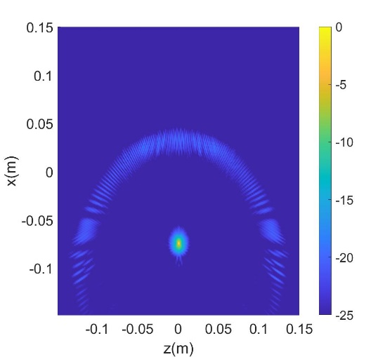
Simulation Results – 3-D PSF
(x-y) PSF
(y-z) PSF
Reconstructed PSF
(x-z) PSF

Slide 6
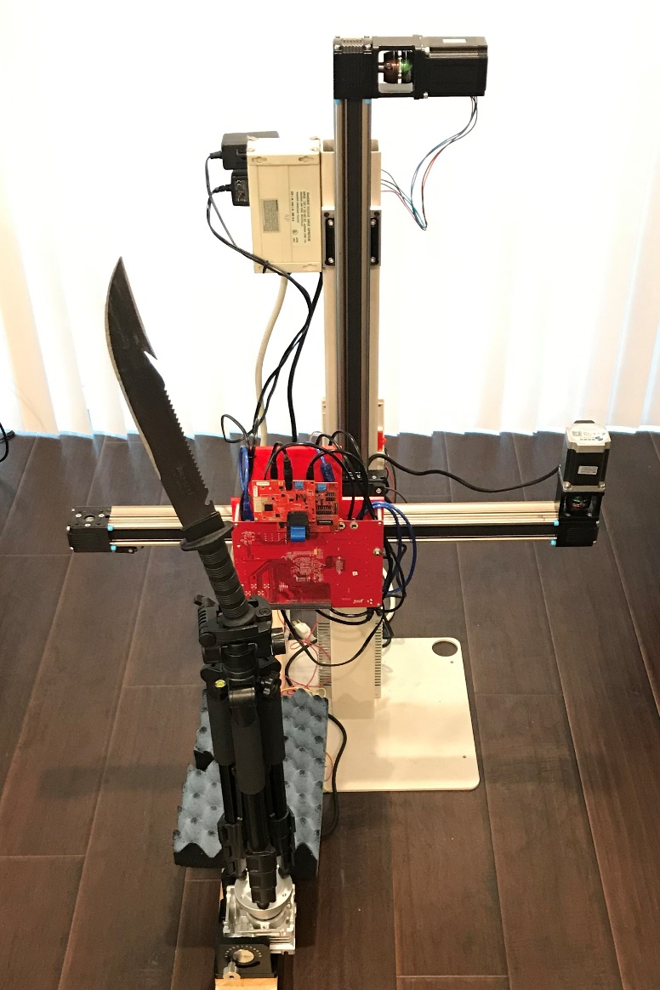
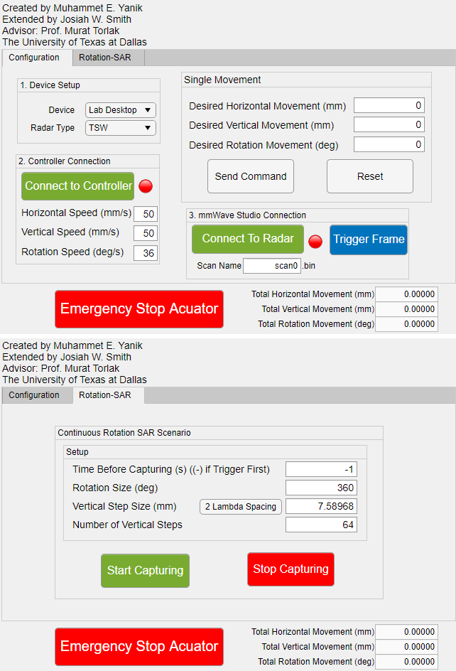

System Setup
x-y-$θ$ mechanical scanner capable of synthesizing rectangular and cylindrical apertures.
Compare rectangular SAR and rotational ISAR
Microcontroller and radar controlled by MATLAB
Vertical Scanner
Notch
TI Radar
Setup Radar
Control Scan
Horizontal Scanner
Rotator
Serrated edge
Notes:
Finally, we assemble a fully integrated system with vertical, horizontal, and rotation scanning capabilities allowing for comparison between rectangular SAR and rotational ISAR. The entire scanner is controlled through a custom-built MATLAB graphical user interface that sets up the radar device and controls the scan.
We will proceed to reconstruct high resolution holographic images of the knife shown to the right. Note the notch and serrated edge of the blade, which will be visible in the subsequent images.

Slide 7
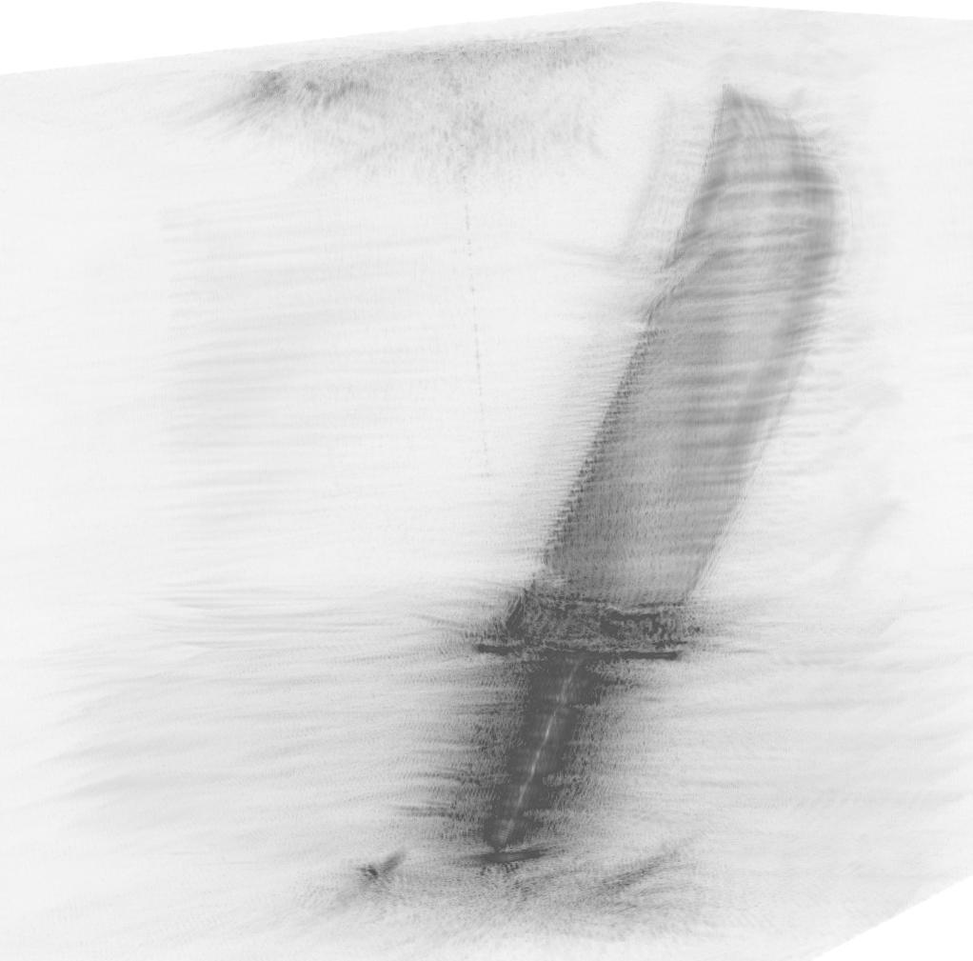
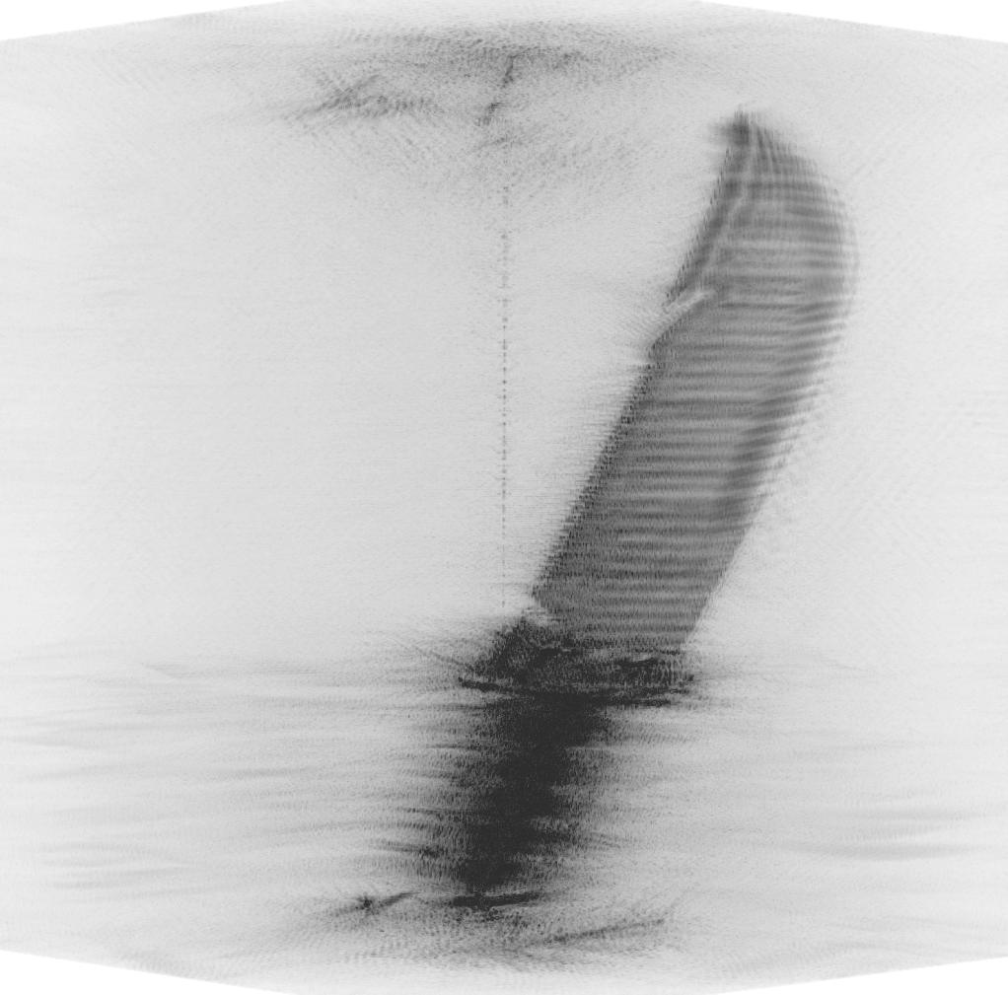
Rotational ISAR – Imaging Results
Cylindrical SISO Array
512 quasi-monostatic vertical elements
137 min per scan
Cylindrical MIMO Array
512 multistatic virtual vertical elements
17 min per scan
Notes:
We first compare images from a SISO array of 512 quasi-monostatic vertical elements spaced by a quarter wavelength. To scan at each of the 512 vertical locations, the entire scan took 137 minutes to complete. In contrast, the scan using a MIMO array of the same size took 17 minutes in total. Both the images show a high-quality reconstruction of the knife blade with the notch and serrated edge visible.

Slide 8
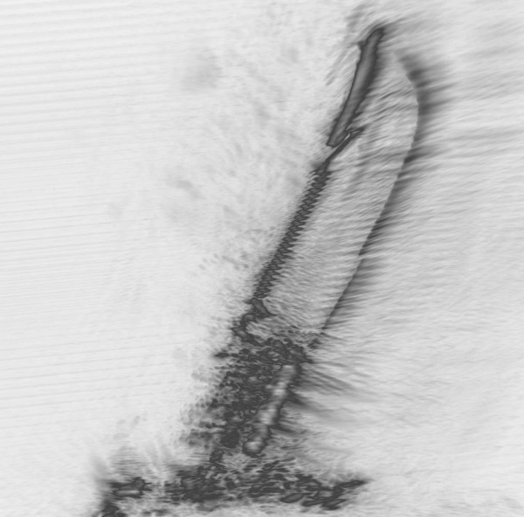
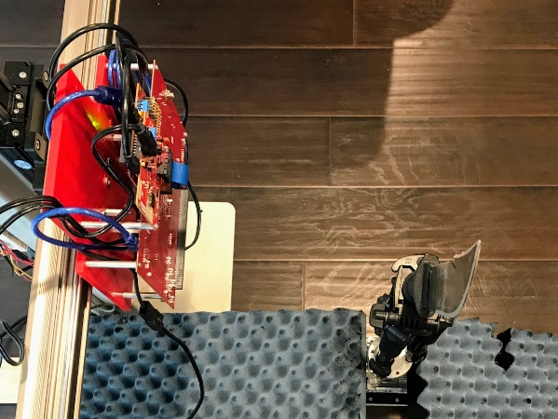
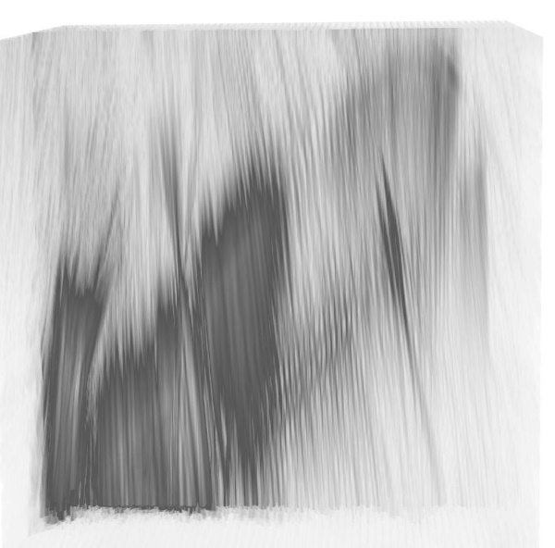
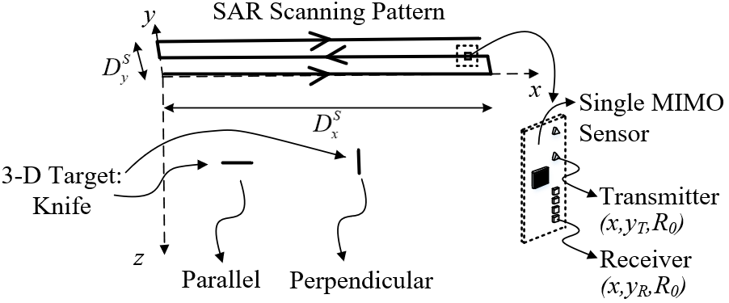
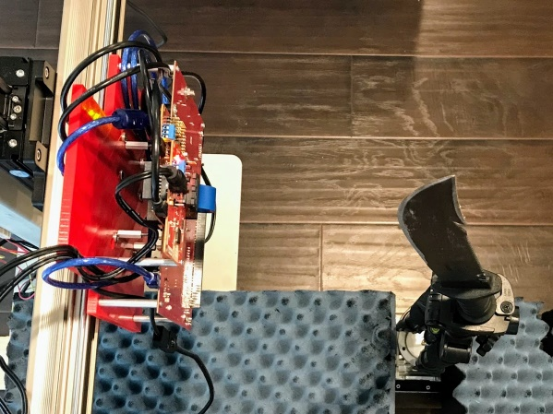
Rectangular SAR – Imaging Results
2-D scan over x-y plane
29 min per scan
Reconstruct 3-D image
Performs well when target is parallel to aperture plane
Suffers in nonideal conditions
Parallel
Perpendicular
Notes:
Next, we use the 2-D horizontal and vertical scanning axes to produce 3-D holographic images from a rectangular SAR aperture. We consider multiple cases, 1) the knife blade is parallel with the x-y aperture plane, and 2) the knife blade is perpendicular to the x-y plane. The orientation of the knife with respect to the scanner has substantial implications on the image quality.
The images on the right compare the reconstructed images of the knife blade when the knife is parallel and perpendicular to the scanning plane.

Slide 9


Rotational ISAR vs. Rectangular SAR
Rectangular MIMO-SAR
Requires specific target rotation with respect to aperture plane
Rotational MIMO-ISAR
Rotation-invariant
Improved spatial resolution
Notes:
This demonstrates the high dependence of the image quality on the knife orientation in the rectangular MIMO-SAR regime. While rectangular SAR can reconstruct high-resolution 3-D images of reflective targets, the rotation of the target drastically changes the quality of the resulting image.
By comparison, rotational MIMO-ISAR is rotation-invariant since the target is scanned across a full 360-degree aperture. Further, this results in improved spatial resolution over the rectangular SAR imaging regime.

Slide 10
Conclusion
High resolution 3-D near-field imaging system based on:
Low-cost system-on-chip mmWave FMCW radars
Multistatic-to-monostatic conversion
Fourier-based rotational ISAR imaging algorithm
Experimental results:
Validate MIMO-ISAR 3-D holographic image reconstruction algorithm
Demonstrate improved scanning efficiency over SISO systems
Establish rotation-invariance advantage of rotational ISAR over rectangular SAR
Notes:
In conclusion, we developed a high resolution 3-D near-field imaging systems based on low-cost system-on-chip mmWave FMCW radars, a multistatic-to-monostatic conversion, and an efficient Fourier-based rotational ISAR imaging algorithm.
Our experimental results validate our novel MIMO-ISAR 3-D holographic image reconstruction algorithm, demonstrate improved scanning efficiency over SISO systems, while maintaining high-resolution image quality, and establish the rotational-invariance advantage of rotational ISAR over rectangular SAR.
Proven in virtual and empirical prototyping, our fully integrated system allows for efficient near-field MIMO-ISAR mmWave imaging offering an elegant solution to many near-field imaging and sensing problems.

